Slide 1










Whiteboardmaths.com
7
2
1
5
© 2004 All rights reserved

Slide 2
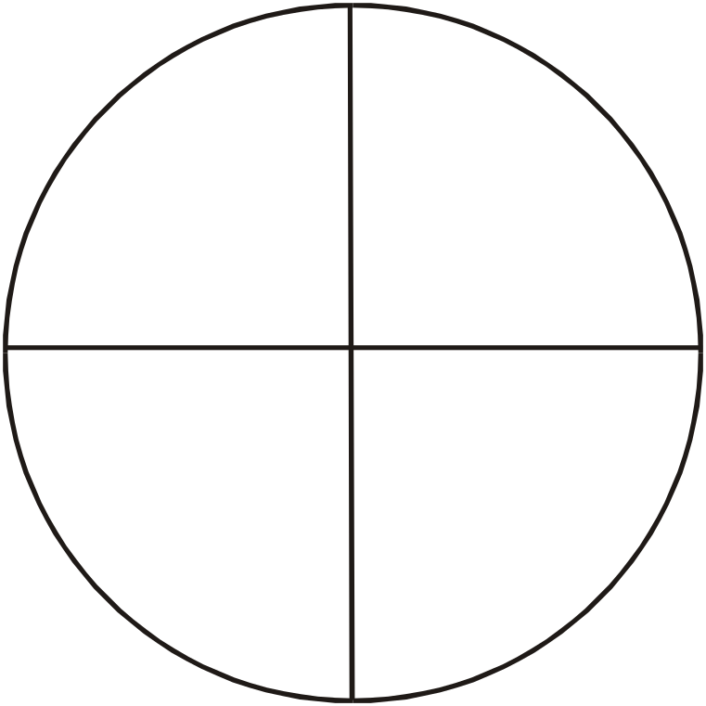
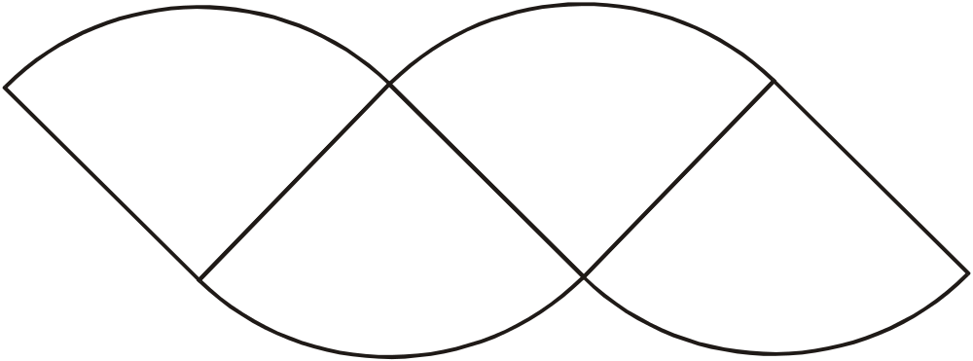
The Area of a Circle
Transform
4 Sectors

Slide 3
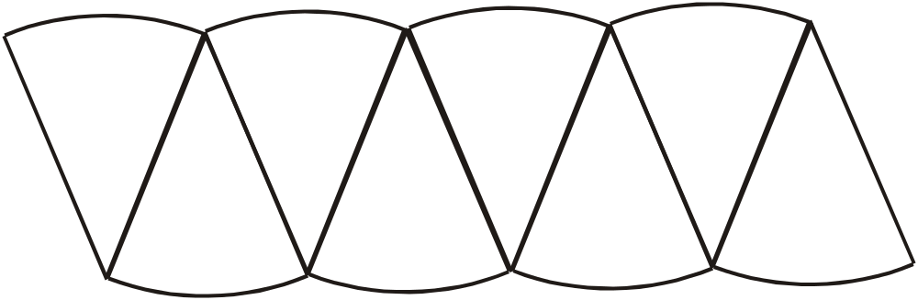
The Area of a Circle
Transform
8 Sectors

Slide 4
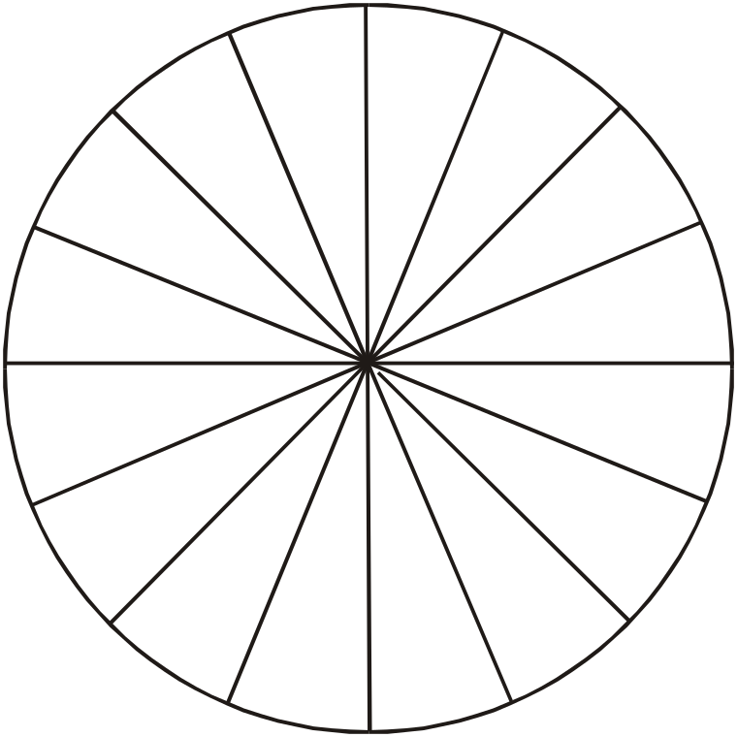
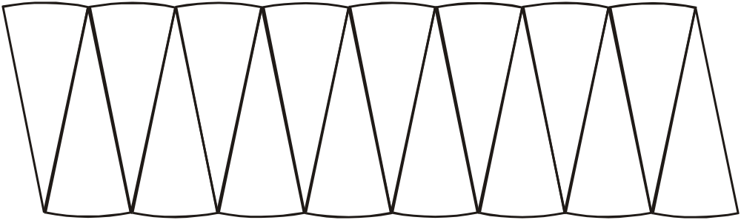
The Area of a Circle
Transform
16 Sectors

Slide 5
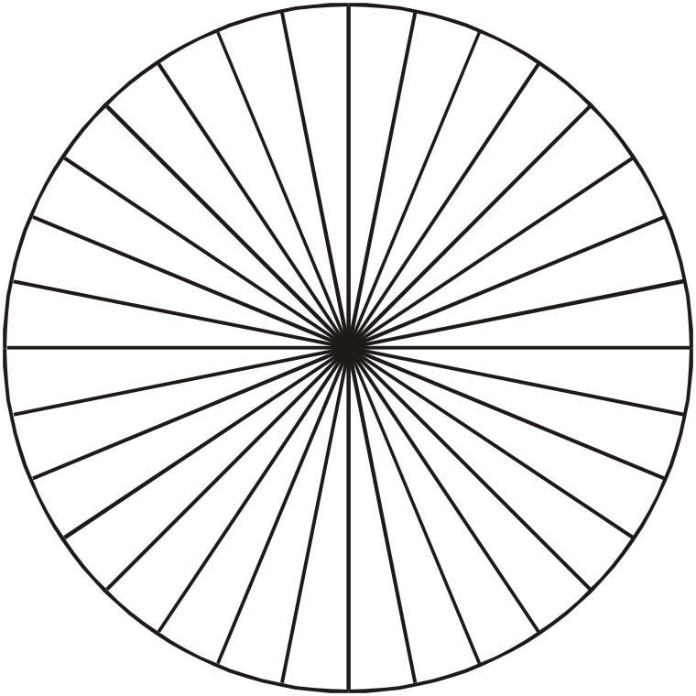

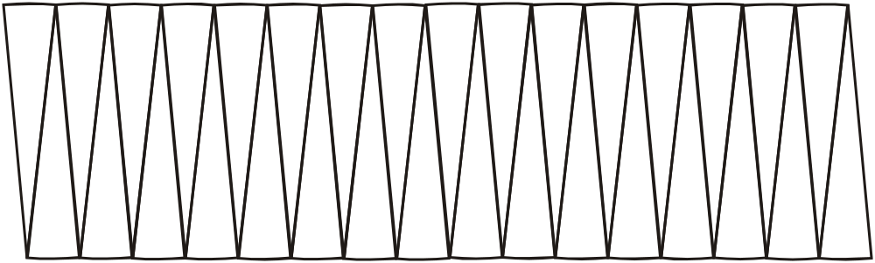
As the number of sectors → ∝, the transformed shape becomes more and more like a rectangle. What will the dimensions eventually become?
Remember
C = 2πr
Transform
πr
½C
?
32 Sectors
?
r
A = πr x r = πr²

Slide 6



The Area of a Circle
A = πr²
Find the area of the following circles.
1
2
8 cm
9.5 cm
r = 8
A = πr²
A = π x 8 x 8
A = 201.06
A = 201.1 cm² (1 dp)
r = 9.5
A = πr²
A = π x 9.5 x 9.5
A = 283.52
A = 283.5 cm² (1 dp)

Slide 7
The Area of a Circle
A = πr²
Find the area of the following circles.
3
4
6 mm
2.4 m
r = 3
A = πr²
A = π x 3 x 3
A = 28.27
A = 28.3 mm² (1 dp)
r = 1.2
A = πr²
A = π x 1.2 x 1.2
A = 4.52
A = 4.5 m² (1 dp)

Slide 8


Find the area of the clock face and radar screen.
A = πr²
12 cm
60 cm
r = 12
A = πr²
A = π x 12 x 12
A = 452.38
A = 452.4 cm² (1 dp)
r = 30
A = πr²
A = π x 30 x 30
A = 2827.4
A = 2827 cm² (nearest cm²)

Slide 9
The Area of a Circle
A = πr²
Find the area of the following semi-circles.
1
2
8 cm
9.5 cm
r = 4
A = ½πr²
A = ½ x π x 4 x 4
A = 25.13
Area = 25.1 cm² (1 dp)
r = 4.75
A = ½πr²
A = ½ x π x 4.75 x 4.75
A = 35.44
Area = 35.4 cm² (1 dp)

Slide 10
The Area of a Circle
A = πr²
Find the area of the ¼ and ¾ circles.
3
4
6 cm
8.5 cm
R = 6
A = ¼πr²
A = ¼ x π x 6 x 6
A = 28.27
Area = 28.3 cm² (1 dp)
r = 8.5
A = ¾πr²
A = 3 x π x 8.5 x 8.5
4
A = 170.23
= 170.2 cm² (1 dp)

Slide 11
The Area of a Circle
A = πr²
Find the radius/diameter of the following circles.
5
6
A = 25 cm² find the diameter.
A = 30 cm² find the radius.
πr² = 25
r² = 25/π
r = √(25/π)
r = 2.82
d = 2 x 2.82 = 5.6 cm 1dp
πr² = 30
r² = 30/π
r = √(30/π)
r = 3.1 cm 1dp

